Slide 1
Using amplicon sequencing to analyze microbial community structure and diversity
Sarah Allard
PhD Candidate in Plant Science, Micallef Lab
March 31, 2015
BYOB

Slide 2
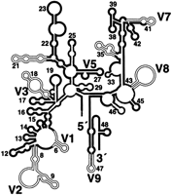
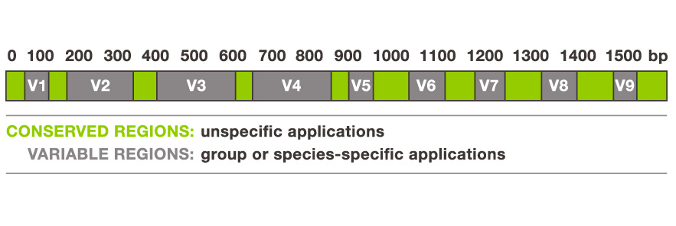
Approaches for examining microbial diversity
Amplicon Sequencing: Who is in the community?
16S rDNA: Bacteria, Archaea
ITS or 18S rDNA: Fungi
Shotgun Metagenomics: What is their functional potential?
Metatranscriptomics: What is the community doing?

Slide 3
Questions you might want to ask
Which of your treatment factors drive differences in community structure and diversity?
Which OTUs are significantly different between samples?
Are there keystone species?
Are there environmental variables that correlate with composition?
What OTUs explain most of the difference between samples?
How do communities change through time?
What metabolic processes are going on in an environment?
Do certain groups co-occur?
From STAMPS at Woods Hole, 2014

Slide 4
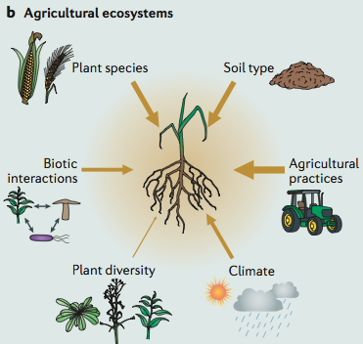
How do agriculture inputs, such as fertilizer and biological control, influence microbial communities in the phyllosphere ?
“Drivers of the rhizosphere microbiota in natural and agricultural systems”
– from Philippot, 2013
Notes:
Spend a long time here, talking about soil amendments too – how much does each drive/shape microbial community structure?

Slide 5
Tomato Microbiome
Phyllosphere: above-ground plant surface
Rhizosphere: area immediately surrounding the roots
Figure 3. Bacterial diversity in roots, bottom leaves, stems, tomatoes, flowers and top leaves of tomato plants using 16SrRNA. Bacterial diversity associated with diverse tomato organs (16S).
Ottesen et al, 2013

Slide 6
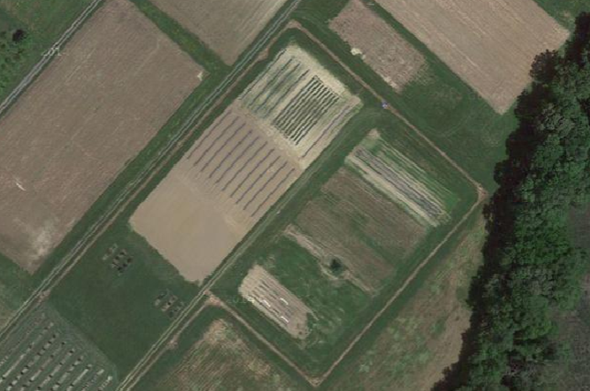
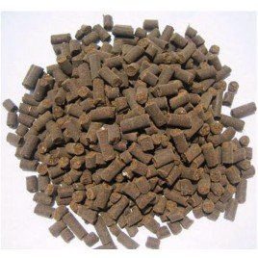

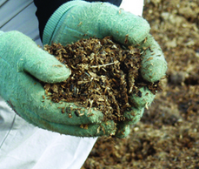
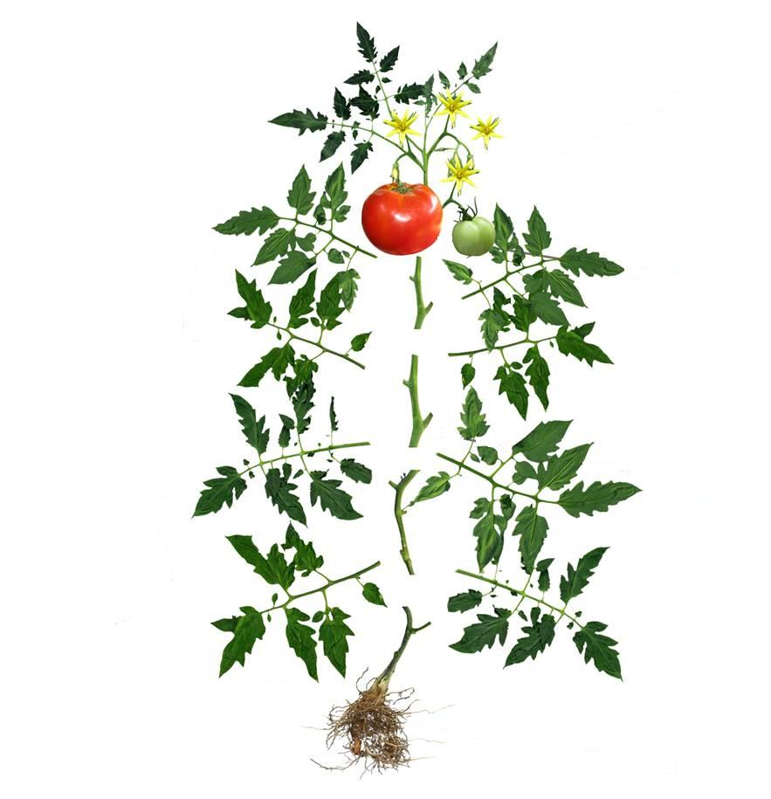
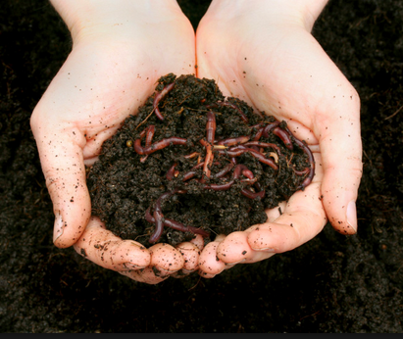


Slide 7
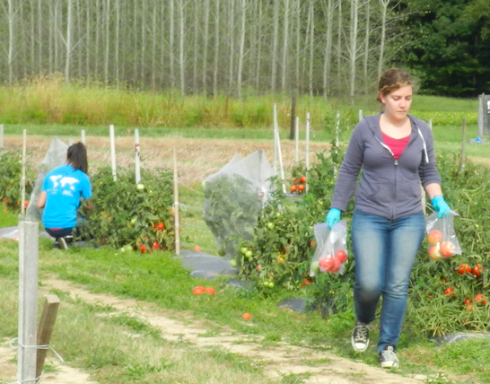
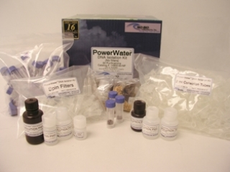
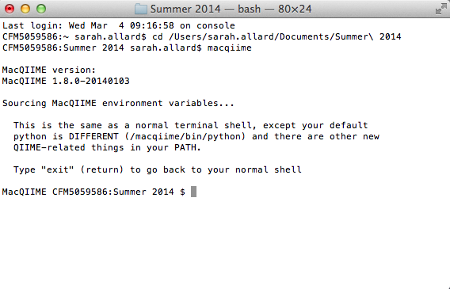
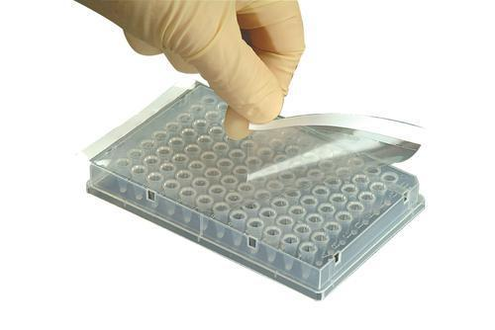
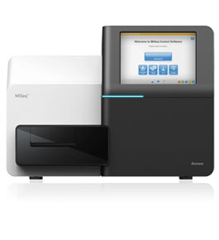


Slide 8
Methods: 16S Data Analysis Workflow
Prepare data
(Move files, assemble paired ends, organize metadata)
Quality filter
(Remove low quality, chimeric, and non-target reads)
Pick open reference OTUs; assign taxonomy
(Align to Greengenes database; make OTU table)
Conduct diversity analyses (alpha and beta diversity)
Visualize data

Slide 9
Quality Filtering
Remove low quality reads (sequencing errors)
Illumina Q score, length
Remove chimeric reads (amplification errors)
De novo detection using UCHIME (within USEARCH, QIIME)
Can be anywhere from 0 to 30% of reads
Remove non-target reads
PhiX
Mitochondria
Chloroplast
Also consider:
Contamination
Singletons can be valid (rare organisms) or invalid (seq errors)
Decide based on ecological relevance and diversity of sample
Notes:
Every read represents an independent read of the source DNA; poor quality sequences become novel organisms or genes

Slide 10
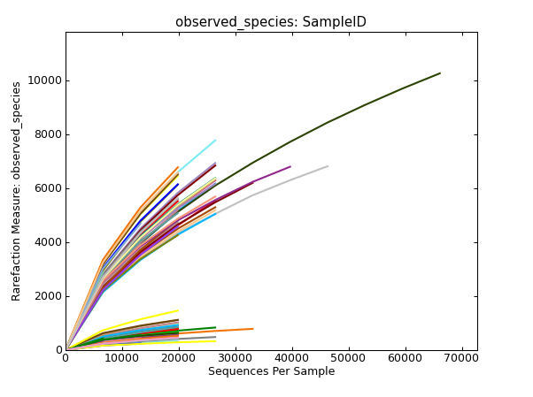
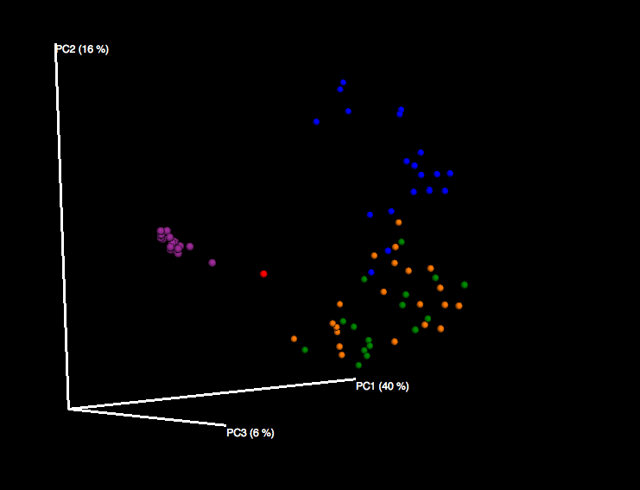
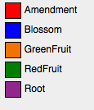
Evaluating diversity and community structure
Alpha diversity: number of OTUs within each sample
Alpha_rarefaction.py
OTU estimations and diversity estimates
Beta diversity: compare OTU composition and abundance between samples and sample types
Beta_diversity_through_plots.py
Emperor
Unifrac
Weighted vs. Unweighted

Slide 11
Other fun things
Group_significance.py
Evaluate significance of taxa of interest using Kruskal-Wallis test
Recommended that you filter out low abundance seqs first
Compute_core_microbiome.py
Lists OTUs common to all samples at different percentages
Make_otu_heatmap_html.py
Make an interactive heatmap
Compare_categories.py
Nonparametric approach to evaluate differences between sample groups (uses Vegan in R)
QIIME Forum

Slide 12
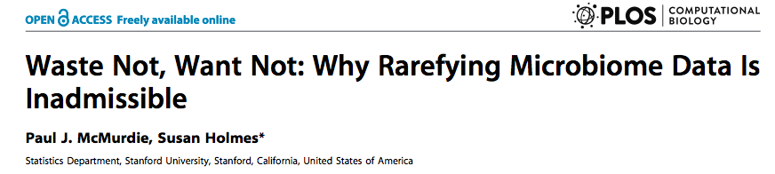
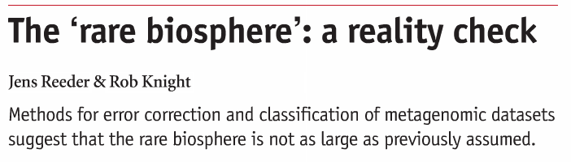
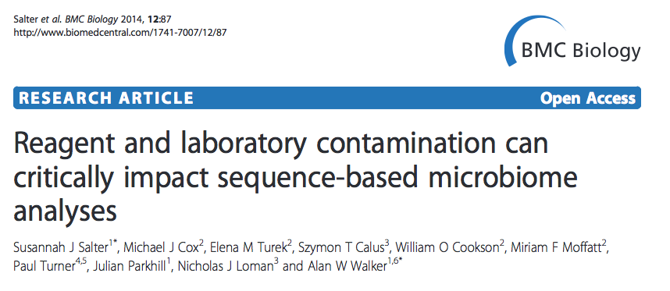
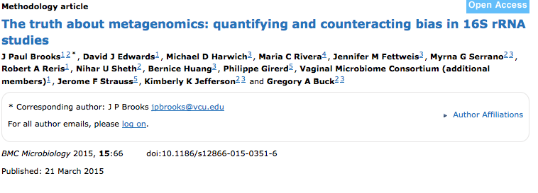
Challenges

Slide 13
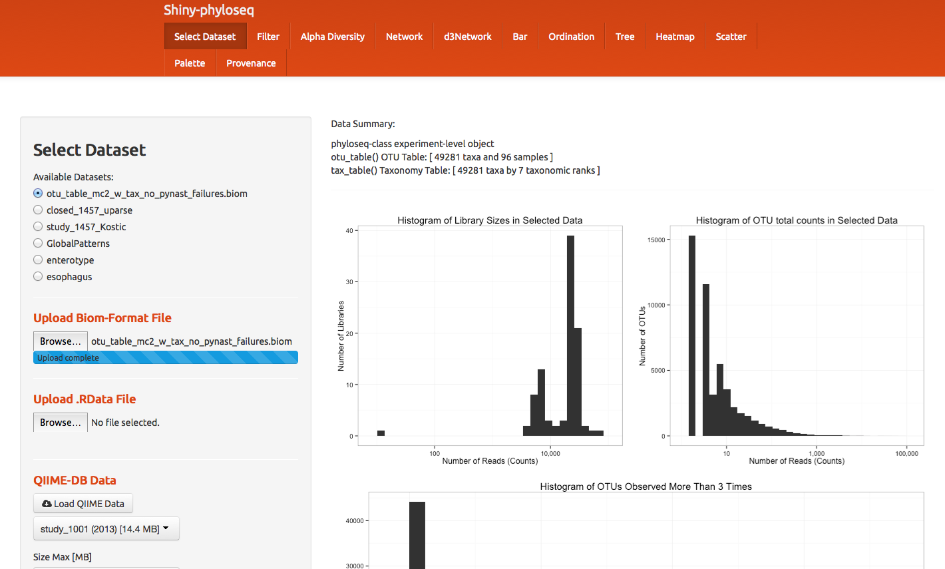
Phyloseq / Shiny visualization and stats without normalizing by read number
“Waste not, want not”
McMurdie, P. J., & Holmes, S. (2013). phyloseq: an R package for reproducible interactive analysis and graphics of microbiome census data. PloS one, 8(4), e61217.

Slide 14
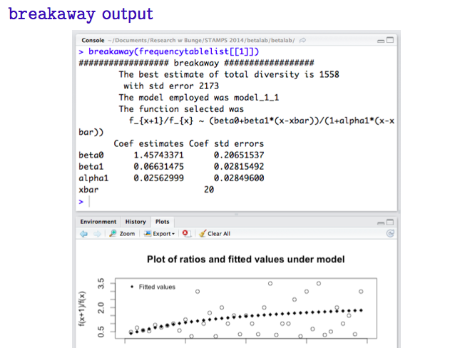
Breakaway and Catchall visualization and stats without normalizing by read number OTU count estimations rather than diversity indices

Slide 15
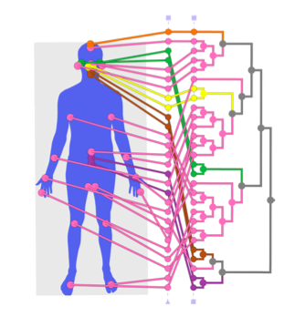
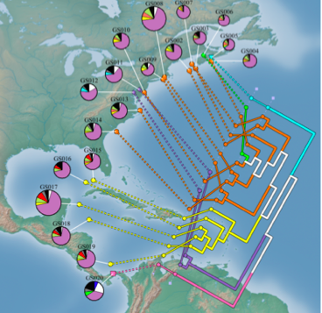
GenGIS map data to locations
Parks, D. H., Mankowski, T., Zangooei, S., Porter, M. S., Armanini, D. G., Baird, D. J., ... & Beiko, R. G. (2013). GenGIS 2: Geospatial analysis of traditional and genetic biodiversity, with new gradient algorithms and an extensible plugin framework. PloS one, 8(7), e69885.

Slide 16
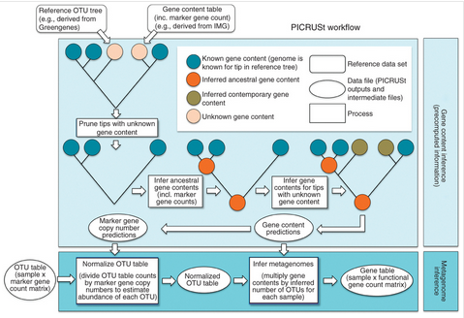
PiCRUST Predictive functional profiling from 16S data
“Like a microscope whose lens is smudged with vaseline”
Langille, M. G., Zaneveld, J., Caporaso, J. G., McDonald, D., Knights, D., Reyes, J. A., ... & Huttenhower, C. (2013). Predictive functional profiling of microbial communities using 16S rRNA marker gene sequences. Nature biotechnology, 31(9), 814-821.

